Slide 1




CSE 4000 : Project/Thesis
Mixed Precision Driven Optimization of Mixture-of-Experts Models for NLP Tasks
Supervised By:
Dr. Sk. Imran Hossain
Associate Professor,
Department of Computer Science and Engineering,
Khulna University of Engineering & Technology
Presented By:
Sumaiya Khan
Roll: 2007031
Department of Computer Science and Engineering,
Khulna University of Engineering & Technology
Date: 15.12.2025

Slide 2
Overview
Introduction
Problem Statement
Objectives
Project Planning
Literature Review
Methodology
AMP Implementation
Result Analysis
Conclusion
References

Slide 3
Introduction
Model scaling increases accuracy but causes high compute and memory cost.
Mixture-of-Expert (MoE) enables sparse computation by activating few experts per input.
MoE models still suffer from training and deployment inefficiency.
Mixed precision reduces memory and speeds up training without accuracy loss.
Combining MoE, mixed precision, and quantization is a promising efficiency solution.

Slide 4
Problem Statement
High memory and computation costs in transformer training.
Inefficiency of full-precision computation in large matrix operations.
Limited understanding of mixed precision and quantization stability in MoE frameworks.
Existing expert balancing methods are often insufficient for maintaining model performance under low precision
MoE increases computational and memory overhead

Slide 5
Objectives
Integrate MoE with mixed precision training.
Apply quantization within MoE experts.
Maintain accuracy under low-precision computation.
Reduce memory and computational cost.
Enable efficient large-scale deployment.

Slide 6
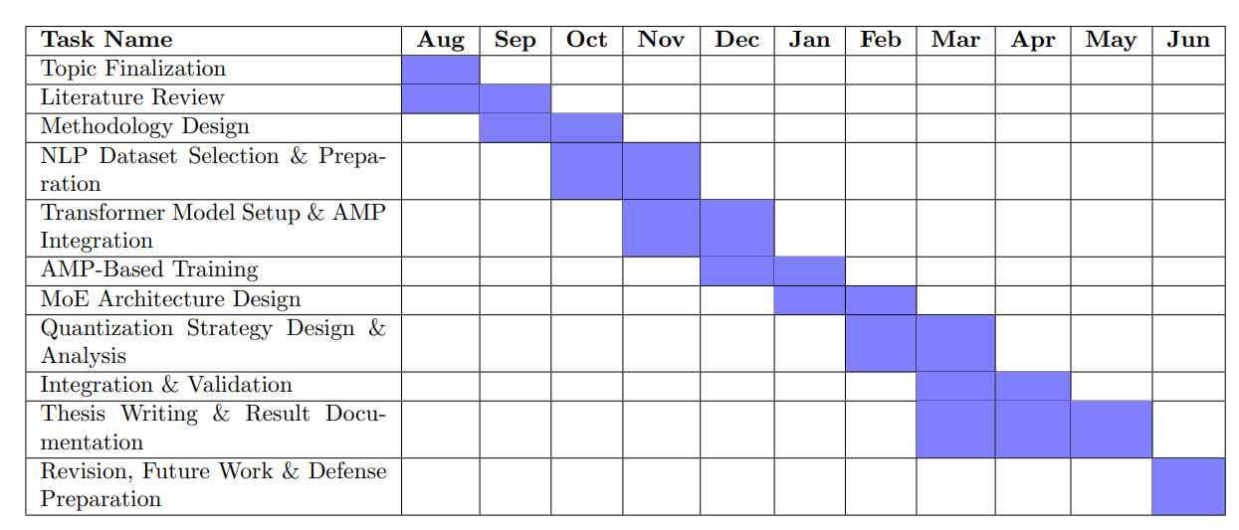
Project Planning
Figure 1 : Gantt Chart for Thesis Planning

Slide 7
Literature Review
Table 1: Literature Review
Serial No | Title | Reviews
1 | A Survey on Mixture of Experts in Large Language Models | Proposed a taxonomy of MoE methods Analyzed gating, experts, and routing strategies Identified expert imbalance and training instability Emphasized need for better regularization and optimization
2 | Mixed Precision Training | Introduced FP16 training with FP32 master weights Used loss scaling to avoid gradient underflow Achieved FP32-level accuracy with higher speed Foundation of modern AMP frameworks
3 | Mixture of Experts in Large Language Models | Comprehensive taxonomy of MoE architectures Analysis of routing, gating, and expert designs Identification of expert imbalance and instability issues Emphasis on efficient optimization and deployment challenges

Slide 8
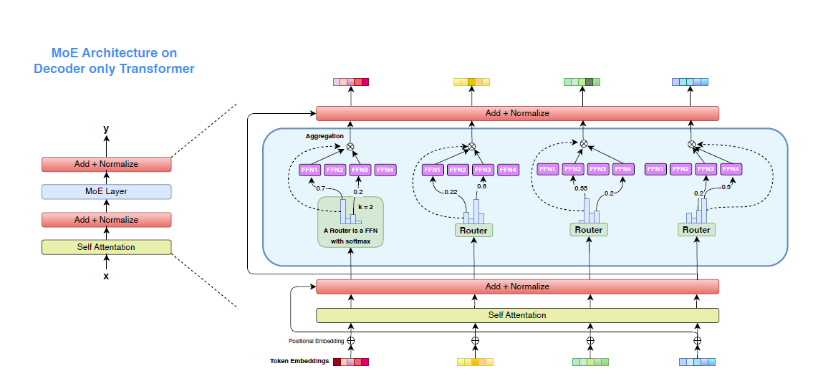
Methodology (Paper 1)
Use Decoder only Transformer Backbone
Insert sparse MoE layer instead
of FFN.
Router selects top-k experts per token.
Aggregate expert outputs with residual normalization.
Figure 2 : MoE Architecture on Decoder
Only Transformer

Slide 9
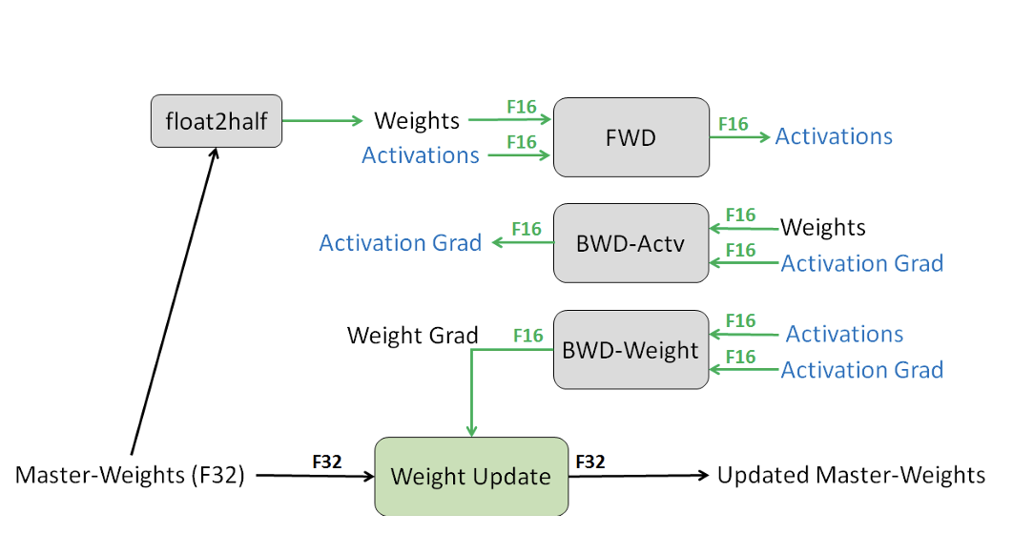
Methodology (Paper 2)
AMP Mechanisms:
Autocasting: FP16 for compatible operations
(e.g., matrix multiplications).
FP32 Master Copy: Weights stored in
FP32 to prevent precision loss.
Dynamic Loss Scaling: Addresses
gradient underflow in FP16.
Figure 3 : Mixed Precision Training Iteration for a layer

Slide 10
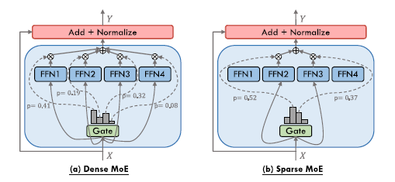
Methodology (Paper 3)
Insert MoE layers in place of dense FFN layers.
Route tokens using a sparse top-k gating network.
Activate only selected experts per input.
Aggregate expert outputs via gate weights.
Enforce expert balance using auxiliary loss.
Figure 4 : An illustration of an MoE layer
in Transformer-based models

Slide 11
Research start
Proposed Methodology
Build MoE Model
Add Mixed Precision
MoE + AMP integration
Expert Routing Analysis
Training Stabilization
Quantization for Efficiency
Trade-off Evaluation
Fix Stability Issues
Quantize Model
Evaluate Performance
Good Trade-offs?
Expected outcome:
Optimized MoE model
Tweak & Improvement
Analyze Expert Imbalance
Ongoing & future work
Figure 5 : MoE with Amp training

Slide 12
Task Selection: NER, SA
AMP Implementation
Data Preprocessing: Normalization, Tokenization, Padding
Model Selection:
BanglishBERT, mBERT
Select tasks and preprocess data
Choose pretrained models and fine-tune.
Train using FP32 and AMP.
Evaluate and compare results to analyze the impact of mixed precision.
Fine-tuning for specific Task
Training Setup:FP32 vs AMP
Metrics:Accuracy/F1/EM,
Time Memory Throughput
Metrics:Accuracy/F1/EM,
Time Memory Throughput
Evaluation
Comparison & Analysis: Impact of Mixed Precision
Figure 6 : Overview of the proposed
AMP training methodology

Slide 13
Diverse Models, Tasks & Datasets
Fine-tuning popular transformer models with FP32 vs. AMP.
BanglishBERT
XLM-R
mBert
BanglaBert
Table 2. Datasets Used for Evaluating AMP on Bangla NLP Models
Sentiment Analysis
BLP-2023
46,643 samples
Pos, Neg, Neutral
Named Entity
Recognition
Bangla-
HealthNER
31,783 samples
7 entity types (IOB format)

Slide 14
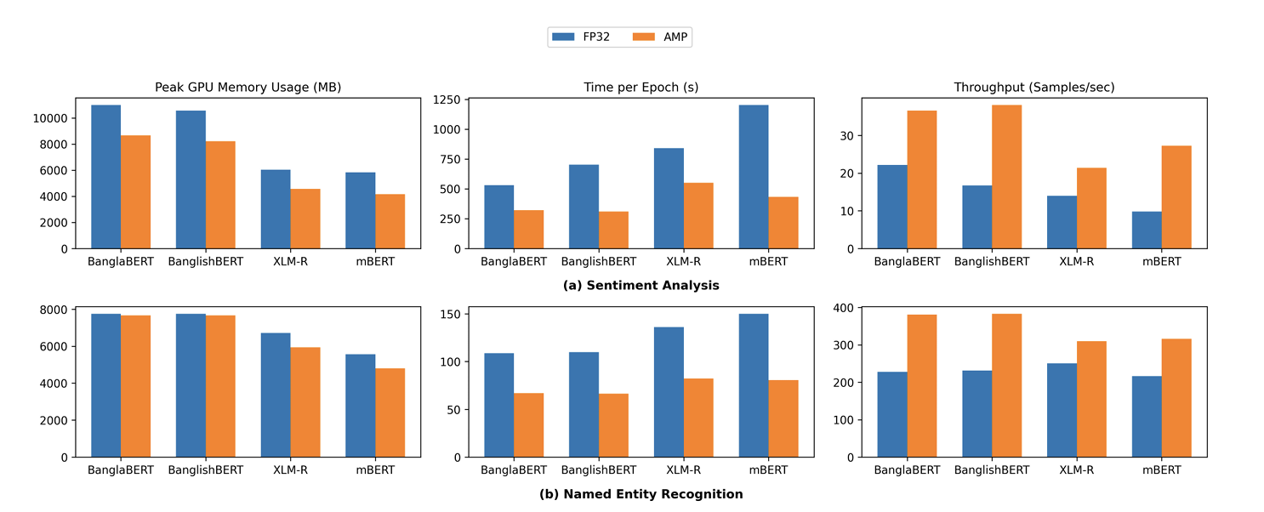
Results: Training Efficiency
Figure 7. Comparative Efficiency Metrics (FP32 vs AMP) Across All Tasks

Slide 15
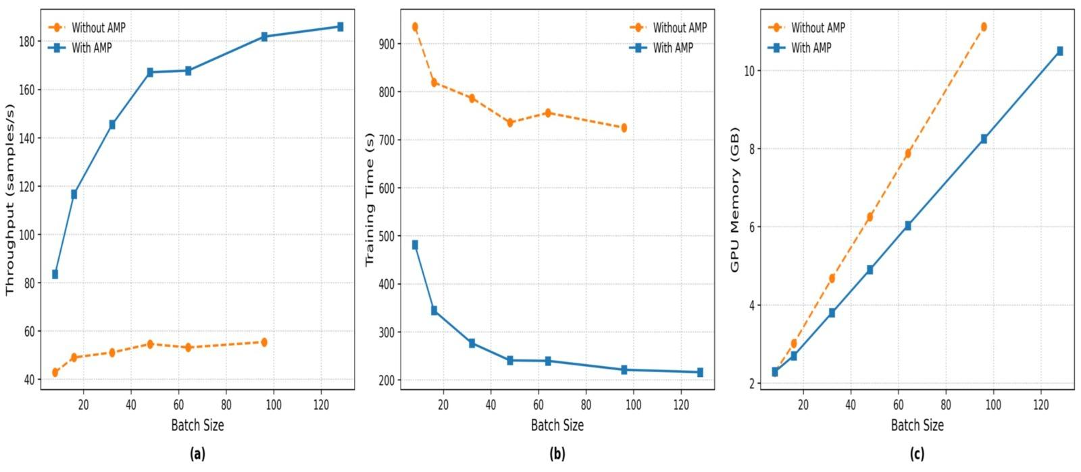
Batch Size Scalability: Unlocking Potential
AMP enables larger batch sizes without Out-of-Memory (OOM) errors.
Figure 8. Comparison of AMP and Full-Precision Training Across Batch Sizes

Slide 16
Why Should AMP + MoE Works?
Synergistic Benefits (AMP + MoE Together)
Component
Individual Benefit
Combined Synergy
AMP
Faster training
Fits larger MoE models in GPU
MoE
Massive capacity, sparse activation
Preserves expressivity, faster training
Together
Expands scale, accelerates training
High-capacity, memory-efficient
training

Slide 17
Conclusion
Proposed: A unified method combining MoE and mixed precision to create efficient, lightweight transformers.
Goal: Achieve high capacity and fast training without losing accuracy.
Significance: Enables powerful model training on limited hardware.
Next Steps: Test on NLP tasks and explore quantized MoE deployment.

Slide 18

References
K. Wang, Z. Liu, Y. Lin, J. Lin, and S. Han, “HAQ: Hardware-Aware Automated Quantization with Mixed Precision,” in CVPR, 2019.
2. Z.Dong, Z. Yao, A. Gholami, M. W. Mahoney, and K. Keutzer, “HAWQ: Hessian Aware Quantization of Neural
Networks with Mixed-Precision,” in ICCV, 2019
G. Xiao, J. Lin, M. Seznec, J. Demouth, and S. Han, “SmoothQuant: Accurate and Efficient Post-Training Quantization
for Large Language Models,” ArXiv, vol. abs/2211.10438, 2022.
E. Frantar, S. Ashkboos, T. Hoefler, and D. Alistarh, “GPTQ: Accurate Post-Training Quantization for Generative Pre-
trained Transformers,” ArXiv, vol. abs/2210.17323, 2022.
J. Lin, J. Tang, H. Tang, S. Yang, W.-M. Chen, W.-C. Wang, G. Xiao, X. Dang, C. Gan, and S. Han, “AWQ: Activation
-aware Weight Quantization for On-device LLM Compression and Acceleration,” in MLSys, 2024.
S. Ashkboos, A. Mohtashami, M. L. Croci, B. Li, P. Cameron, M. Jaggi, D. Alistarh, T. Hoefler, and J. Hensman,
“QuaRot: Outlier-free 4-bit Inference in Rotated LLMs,” ArXiv, vol. abs/2404.00456, 2024.

Slide 19
THANK YOU
For your attention
Any Questions?

